Slide 1
Machine Maintenance and Performance Summary
16th Aug 2024

Slide 2
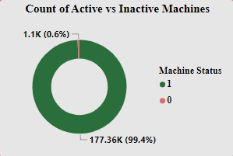
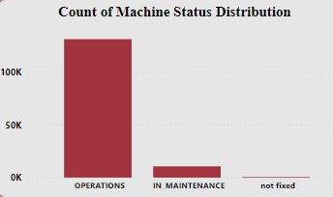
Machine Activity Analysis:
Pie chart showing 99.4% active and 0.6% inactive machines out of the total.
Bar chart showing the distribution of different machine statuses by count, where very few machines were observed that didn't get fixed, but most machines are either operational or under maintenance.

Slide 3
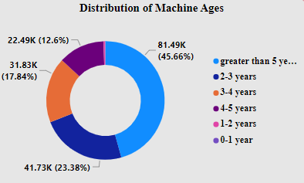
Machine Age Analysis:
Pie chart showing the distribution of machine ages by count, 45% of the machines are over 5 years old, followed by 23% between 2-3 years, 17% between 4-5 years, and so on, with very few machines under 1 year old.

Slide 4
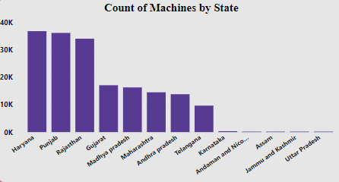
Geographical Analysis:
Bar chart showing the number of machines in each state, with the highest count in Haryana, followed by Punjab and Rajasthan.

Slide 5
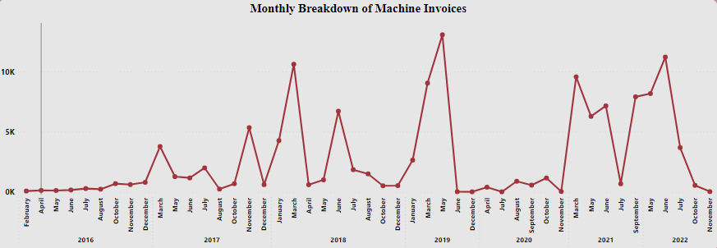
Monthly Breakdown of Machine Invoices
Line chart showing the number of machines invoiced per month.

Slide 6
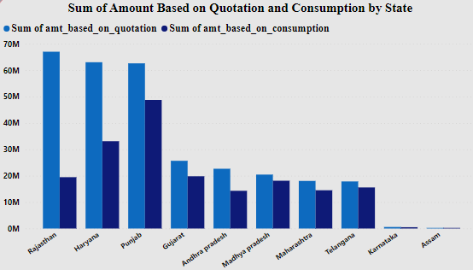
Amount Based on Consumption vs Quotation
Bar chart showing the total amount based on consumption and quotation by state.

Slide 7
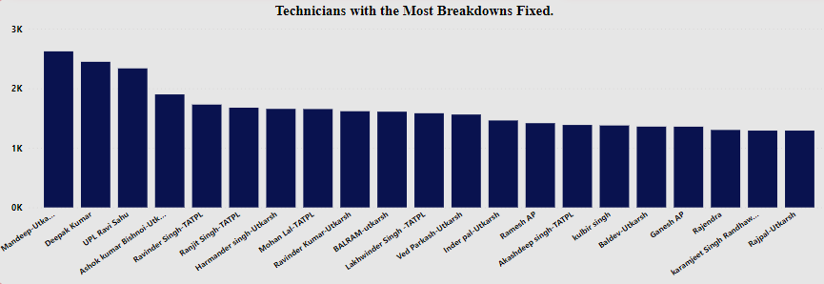
Top Technicians Analysis
Bar chart showing top 20 technicians with the most breakdowns fixed.

Slide 8
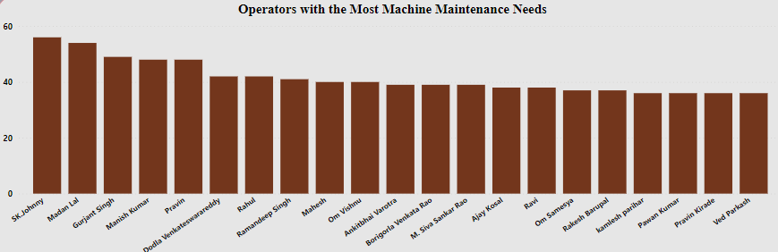
Top Operators Analysis
Bar chart showing top 20 operators with the most machine maintenance needs.

